Slide 1
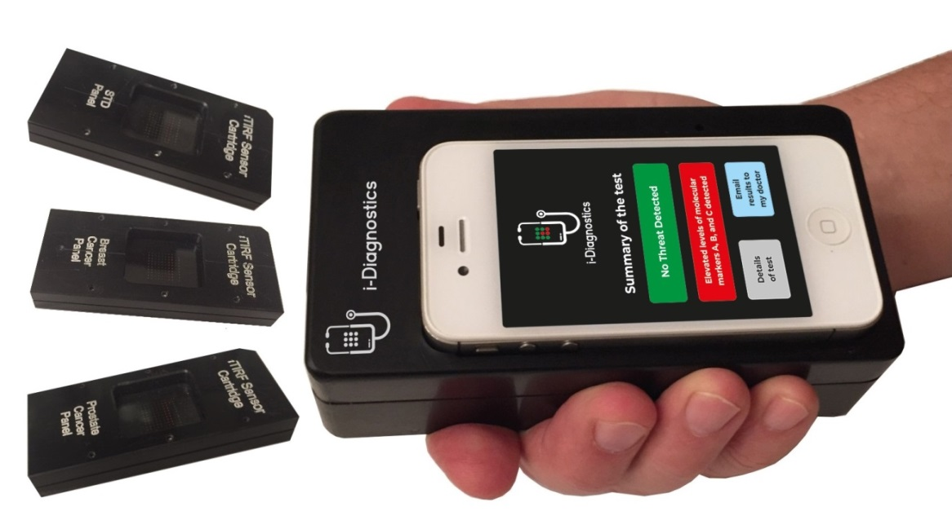
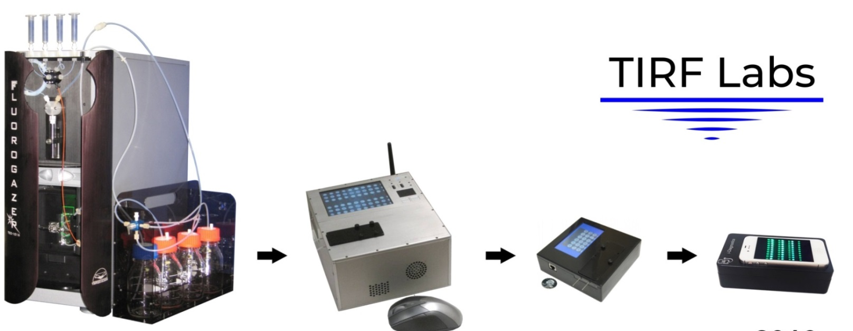
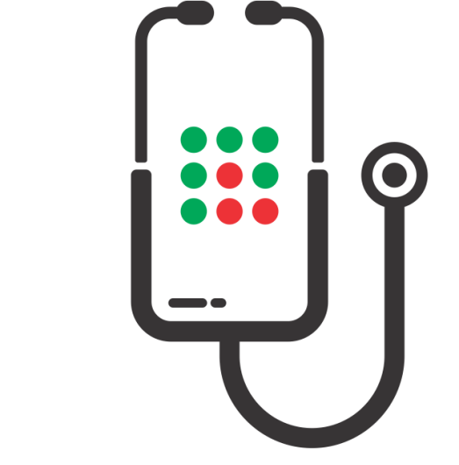
i-Diagnostics and TIRF Analytix
Open Source Platform Technology for Global Biological Security
Non-profit project to prevent pandemics
and minimize the damage from existing diseases
Dr. Alexander Asanov, CEO, TIRF Labs
info@TIRF-Labs.com
www.TIRF-Labs.com

Slide 2
Global Infrastructure for Biological Security
Is Necessary for Preventing Pandemics
Rapid Diagnostics and Proactive Intelligence Are Front Lines of Biological Security
COVID-19 has demonstrated the necessity of global infrastructure for localizing the outbreaks of infections and preventing pandemics. In 2008-2016, biological security experts foresaw that RNA-virus pandemics are coming and stimulated the US government to create an infrastructure for proactive intelligence with advanced diagnostics as its frontline [Rfe.1: 2016 PCAST letter to US President]. However, the government disregarded this necessity. In 2020, Bill Gates, who invested millions of dollars into diagnostics, stated that “… most COVID-19 tests in the US are 'completely garbage‘ ” [1, 2].
Rapid and accurate diagnostics is important for virtually all aspects of biological security. We envision a global infrastructure based on open source diagnostic platform available to all research groups worldwide, as well as affordable for home-use by general public.
TIRF Labs team pledges to make the TIRF Analytix and i-Diagnostics and to be such platforms available to all research groups worldwide, as well as the handheld devices for accurate, home-use tests available for all. We foresee that this non-profit project will create the necessary infrastructure, prevent future epidemics and minimize the damage from existing diseases. TIRF Labs team is uniquely positioned in this area and our way to give back to society is to create such open source platform for global infrastructure of precision medicine, home-use diagnostics, single molecule biology, and for rapid drug screening.
www.TIRF-Labs.com

Slide 3



Natural and Artificial Pandemics
Security experts concur that naturally occurring and man-made pathogens impose one of the greatest threats on humanity. Survival of humanity critically depends on our capability of controlling pandemics. Recent COVID-19 killed ~7 millions. In 1918, the Spanish flu killed ~50 millions, more than WW1, WW2, Korean, and Vietnam wars combined.
Biotechnologies have provided greatly to prosperity of mankind. However, they come with the risks of humanity self-eradication. Bioprinting will be soon available to millions. A. Turchin et al. (2018) in the paper “Artificial Multi-pandemic… Catastrophic Risk…” (ref. [3] slide 16) assumes that biohackers, likely teenagers, will be the most likely source of new pathogens capable of causing global biological catastrophe. Prevention of pandemics requires proactive steps that include early diagnosing. However, current diagnostic tests are too slow and too inaccurate. i-Diagnostics – precision tests for home-use will solve these problems.
Problems with the Current Diagnostics
Tests are expensive
In 2020 PCR tests for COVID-19 cost $1,800.
Tests are slow
In the US, average turnaround time is 1-3 days.
Tests are inaccurate
Too high rate of false-negative and false-positive results.
www.TIRF-Labs.com

Slide 4
i-Diagnostics and TIRF Analytix – Necessary Safety Net for Humanity
Revolutionary New Approach for Biological Security
TIRF Labs was founded by an internationally recognized expert in the area of CBRNE security, Dr. Alexander Asanov. He invented the i-Diagnostics and TIRF Analytix platform technologies that are uniquely well-suited for the envisioned biosafety infrastructure. In 1999-2018, Alexander served as the Principal Investigator on BAA and SBIR grants awarded by the US government totaling $4.3M. He assembled a team of scientists and engineers and developed advanced analytical instruments for Total Internal Reflection Fluorescence (TIRF) [www.TIRF-Labs.com]. TIRF Labs pioneered several ground breaking discoveries using the TIRF technique for life science applications. Over 200 research groups worldwide acquired TIRF products, generated unique research data and published articles in leading scientific journals [1].
We inquire about your help for non-profit funding of our i-Diagnostics/TIRF Analytix project, and for promoting the project to The Giving Pledge members or similarly situated philanthropists. It is important that the global biosecurity infrastructure is not affected by commercial interests. Therefore, this project does not pursue a for-profit objective. Our goal is to make precision diagnostics affordable to everyone and the open source TIRF Analytix platform available to all research groups worldwide.
Open Source status will enable fusion of the collective knowledge of diagnostic and drug screening communities and lay the foundation for the infrastructure, which will prevent pandemics and minimize the damage from existing diseases.
www.TIRF-Labs.com

Slide 5
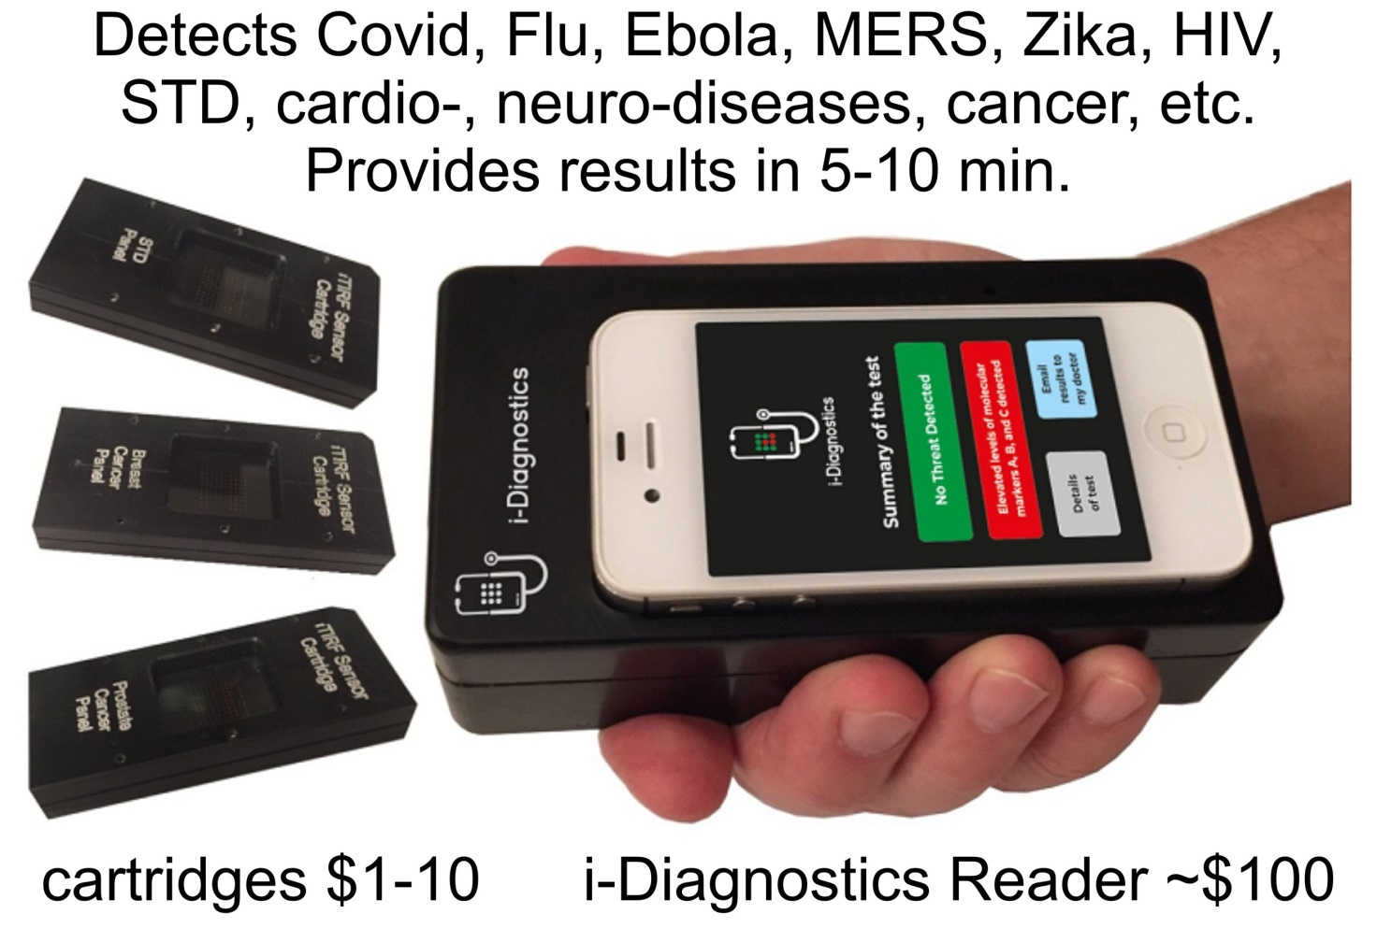

i-Diagnostics - Accurate and Rapid Tests for Home-use to Prevent Natural and Man-made Pandemics
Our goal is to make i-Diagnostics devices affordable to every family on the globe, and the open source TIRF Analytix platforms – to all research groups worldwide. Accurate, rapid, personalized, yet affordable diagnostics will improve many aspects of healthcare and enable a multitude of applications. i-Diagnostics unsurpassed accuracy comes from its ability to detect a panel of biomarkers of several classes simultaneously, including proteins, nucleic acids, metabolites, and certain chemical agents with ultimate sensitivity down to single molecules. i-Diagnostics® is robust, inexpensive and user-friendly for home-use, similar to the pregnancy test.
i-Diagnostics® provides a unique solution that allows to general public worldwide to test themselves at home for pathogens and diseases.
Open-source i-Diagnostics and TIRF Analytix platforms allow for the rapid development of new testing kits in the event of novel pathogen emergence.
www.TIRF-Labs.com

Slide 6
Powerful Combination of High Sensitivity, Accuracy, Speed, and Affordability
i-Diagnostics and TIRF Analytix are technologies, where the information about new pathogens can be “dropped in” to start volume manufacturing of diagnostic tests in a matter of several hours.
Distinctive Features of i-Diagnostics
      Super-sensitive detection of proteins, DNA/RNA, metabolites, and selected chemical agents.
      Simultaneous multiplexed detection of up to thousands of molecular markers in a small sample of biological fluids, including saliva, sputum, urine, and whole blood.
      Certain biomarkers do not endure shipping and certain sample preparation procedures.
      i-Diagnostics® allows for testing at point-of-care, in the field by first-responders, or at home.
      Minimal sample preparation is necessary to perform the test.
      i-Diagnostics development tools are available to the entire diagnostic and R&D community.
      Open Innovation Business Model will involve up to 40,000 research groups worldwide.
      Several thousands of healthcare, agricultural, environmental, and other applications.
www.TIRF-Labs.com

Slide 7
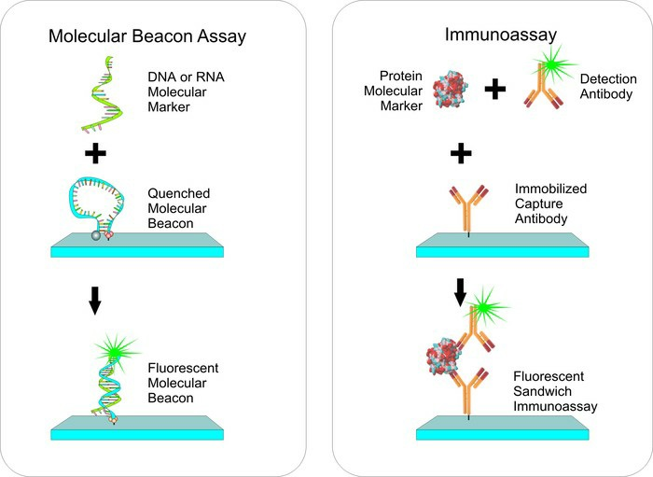
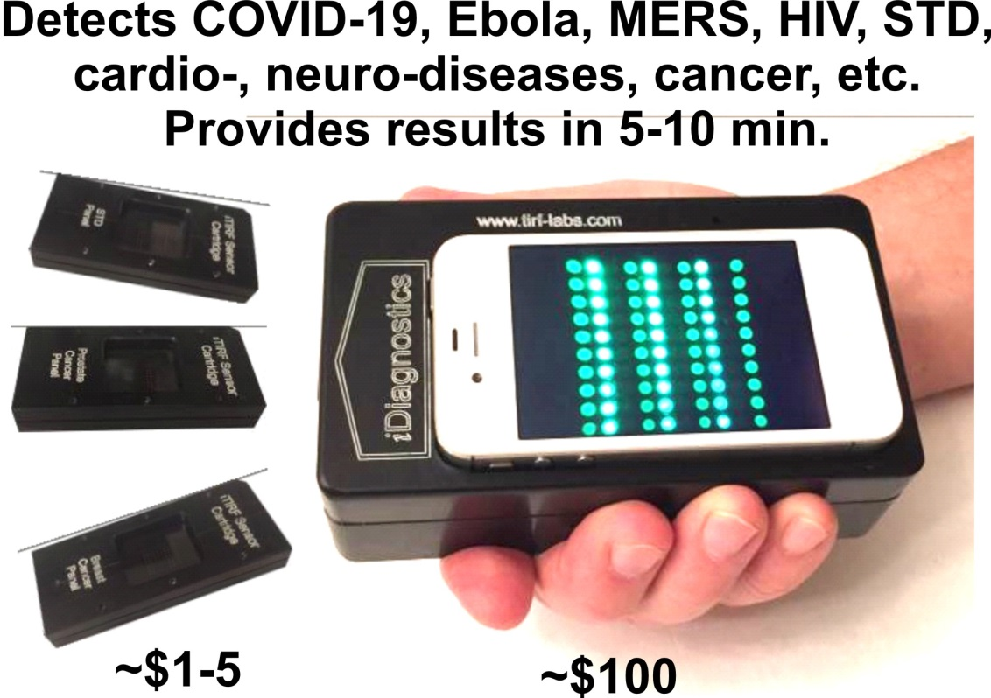
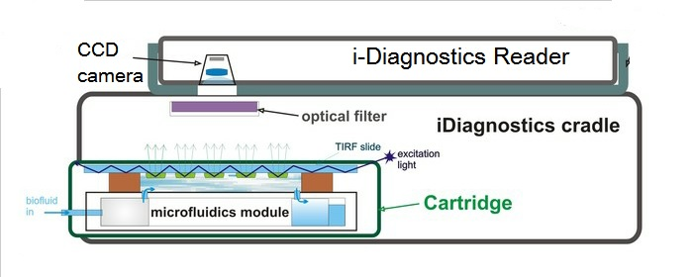
How i-Diagnostics Works?
The underlying technology of i-Diagnostics and TIRF Analytix uses the principles of real-time TIRF microarrays to simultaneously detect four classes of molecular markers – DNA, RNA, proteins, and metabolites in bodily fluids such as saliva, urine, sweat, blood, and other fluids.
Preparation
A biological fluid, e.g. blood, urine, saliva flows over the microarray of bioassays. Each bioassay contains an affinity molecule, which specifically binds only the specific target biomarker, which results in de-quenching or emerging of fluorescence.
Detection
Excitation light propagates inside the TIRF slide reflecting from the top and the bottom. A microarray of bioassays is printed at the bottom surface. If a biomarker is present, respective spot of the microarrays fluoresces, and the emission is detected by low-light CCD camera.
Analysis
The kinetics of fluorescence response is analyzed by i-Diagnostics app; concentrations of multiple bio-markers are derived; the data are combined with clinical symptoms entered into the app; and in 5-10 minutes after applying the sample, test results are reported.
Principles of i-Diagnostics are described at the URL http://www.TIRF-Labs.com/i-diagnostics
www.TIRF-Labs.com

Slide 8

Why are i-Diagnostics and TIRF Analytix so Uniquely Advantageous?
The answer lies in the phenomena of Total Internal Reflection and the Evanescent Wave, the main actors in real-time TIRF microarrays, the underlying technology of i-Diagnostics and TIRF Analytix
TIRF phenomena provides exceptional surface selectivity and enables the ultimate limit of detection - down to single molecules.
TIRF is capable of detecting a multitude of molecular markers of four classes simultaneously, a feature not found in any other technology.
TIRF microarrays require minimal sample preparation.
Results are obtained in a matter of 5-10 minutes.
This supersensitive, accurate and rapid technology, can be downsized to an inexpensive handheld device for home-use with disposable cartridges that cost $1-10.
We are not aware of any other technology that is sensitive, accurate, and rapid, detects all four classes of biomarkers, and yet is affordable.
Our progress in TIRF microarrays spanned from large bench-top instrument, through portable sensors, to small handheld devices.
In 2016, we discovered that silk fibroin enhances TIRF microarrays so one can use a cellphone camera.
www.TIRF-Labs.com

Slide 9
i-Diagnostics Applications
Prevention of pandemics and epidemics
Diagnosing of infection diseases: SARS, influenza, Ebola, HIV, Zika, STDs, etc.
Diagnostics and prognosis of cancer
Diagnostics and prognosis of cardio-vascular diseases
Diagnostics and prognosis of Alzheimer's and other neurological disorders
Drug development studies
Longevity and rejuvenation studies
Food and water safety applications
Military and civil biodefense applications
Forensic applications
Environmental applications
Agricultural analyses and studies
As soon as i-Diagnostics becomes popular, many routine analyses of blood, urine and other bodily fluids that currently are performed in clinical labs, will migrate to the i-Diagnostics device
Along with the main goal of home-use, family doctors, cardiologists, dentists, first responders, pharmaceutical companies, food safety, agriculture, and environment protection specialists have expressed their interest in using i-Diagnostics for their applications
There are thousands of new applications that can be developed for the i-Diagnostics platform
www.TIRF-Labs.com

Slide 10
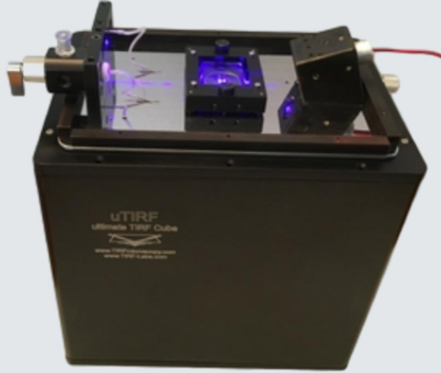
i-Diagnostics and TIRF Analytix Open Source Platform
Open Source Platform model will be used in this project to create global network of experts, which will enable the exchange of intellectual property between collaborators. TIRF Labs is already an integral part of the global diagnostic community. We have supplied our advanced TIRF instruments to over two hundred of research groups worldwide and have created the prototype of the network, which will lay the foundation for an extended biological safety network. TIRF Labs has already supplied our TIRF Analytix and i-Diagnostics development tools to several research groups and received enthusiastic responses from them. We will supply to R&D community our patented technologies as open-source platform to facilitate the development of applications. Our unique hardware, software, cartridge blanks, development tools, reagent kits, methods and protocols will help to interface existing bioassays with the i-Diagnostics platform and develop new assays and tests
LICENSE
RESEARCH
DEVELOP
i-Diagnostics® licenses TIRF patents and provides application development kits (ADK) to universities and industry researchers
Researchers around the world design specific applications and tests to detect biomarkers they know best
Using the input of experts around the globe we will expand the applications of our i-Diagnostics platform
uTIRF station – one of the development tools
www.TIRF-Labs.com

Slide 11
Why Non-profit Status of i-Diagnostics Project Is Important?
In 2010-2024 commercial interests prevailed in FDA, CDC, NIH, and other healthcare-related US agencies. As the result, pandemic prevention technologies, inexpensive and efficient off-label drugs such as Ivermectin and Hydroxychloroquine, did not make it to the market. Commercial interest of large corporations also blocked the path for accurate and inexpensive diagnostics. There is no analogy and no competition to i-Diagnostics. However, in 2010-2024 all US government agencies, including NIH study sections, NSF panels of reviewers, and DARPA program managers were controlled by large pharma and biotech firms that promoted their commercial interests.
COVID-19 pandemic demonstrated the necessity of independent infrastructure based on golden scientific standards, unaffected by commercial interests. We believe that non-profit status of i-Diagnostics project is of paramount importance for prevention of pandemics. We declined the for-profit route and pledged to make TIRF Analytix and i-Diagnostics genuine Open Source platforms available to everyone. Thousands of research groups worldwide have expressed their interest to develop applications in their areas of expertise, which will enable a multitude of cartridges for i-Diagnostics gadgets. Global network of independent users coordinated by a non-profit administrators will build the infrastructure for localizing the outbreaks and preventing the emergence of pandemics. We envision a large social impact of i-Diagnostics endeavor and address our request for funding to The Giving Pledge, other philanthropists, and the US Government.
11
www.TIRF-Labs.com

Slide 12
Prior Funding, Research Network Expansion, and R&D Goals
In 2014, the US DOD performed a comprehensive survey of molecular diagnostic methods and ranked high our prototype of i-Diagnostics for both biological and chemical detection [1]. To date, we believe i-Diagnostics holds a unique combination of features that keeps the technology unrivaled.
To make the i-Diagnostics an open-source platform, develop basic applications, refine the prototype for home-use, and lay the foundation for the biological safety network, TIRF Labs is seeking ~$2 million to start the Phase 2.
The mission of this project is to create a mega-diagnostic platform for biological safety infrastructure by making i-Diagnostics technology an open source platform and the handheld precision diagnostics available to everyone, which is necessary for preventing future pandemics.
The significance of this project goes far beyond the scope of medical diagnostics.
Together with the envisioned handheld device, we are offering to the research community the entire line of TIRF Analytix instruments, development tools, methods, protocols and suppliers that facilitate all stages of diagnostics development.
This project will create a network of experts, consolidate efforts of international teams of medical doctors, healthcare professionals, administrators, businessmen, and grassroots enthusiasts, creating the powerful infrastructure for biological security.
www.TIRF-Labs.com

Slide 13
i-Diagnostics Business Plan Outline
12 months
24 months
36 months
48 months
Project launch
Manufacture Application Development Kit (ADK)
Design and prototype iDiagnostics reader and cartridge
Raise $2 million to start Phase 2 efforts
18-24 months
Distribute ADK tools
License patents and facilitate IP exchange
Finalize design for iDiagnostics reader and cartridge
36 months
Integration of new arrays and diagnostics panels
Raise $64 million for manufacturing and integration
48 months
Large-scale manufacturing and distribution of iDiagnostics reader and cartridges for 12-20 applications including SARS, other infectious diseases.
Panel of ~30-40 assays for personalized treatment of infectious diseases
Deliverables 18-24 months: TIRF Labs will refine the development and supply TIRF Analytix instruments, including uTIRF station and i-Diagnostics Application Development Kit (ADK), supplies, manuals, protocols, reagent kits, cartridge blanks, sample prep modules to other research groups that are developing molecular diagnostic applications. The ADK and uTIRF will facilitate assay development, creating panels of biomarkers, and pre-clinical testing
Deliverables 48 months: TIRF Labs will start manufacturing hand-held i-Diagnostics devices and begin supplying them to all interested parties, including general public
www.TIRF-Labs.com

Slide 14
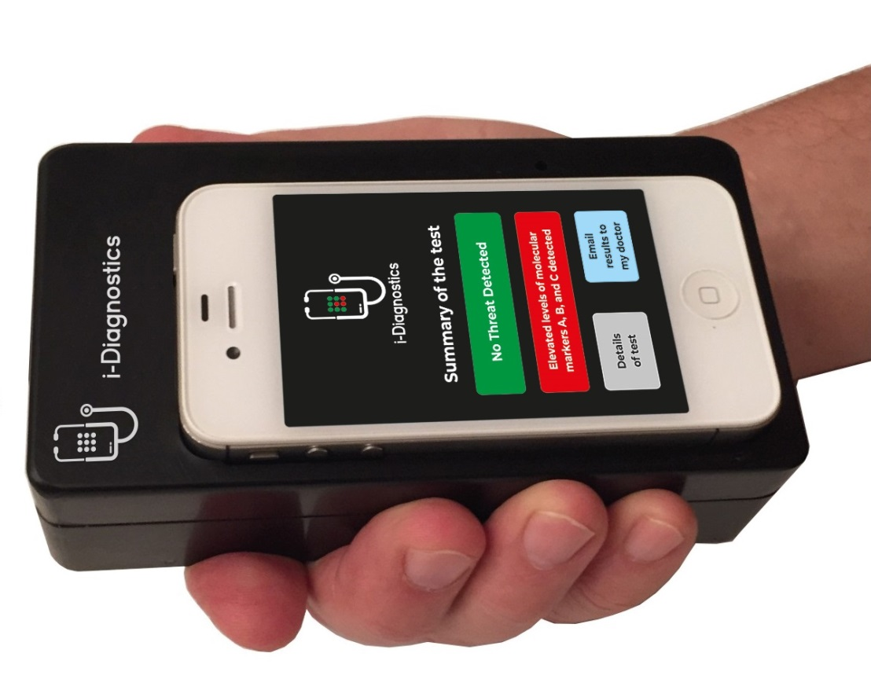
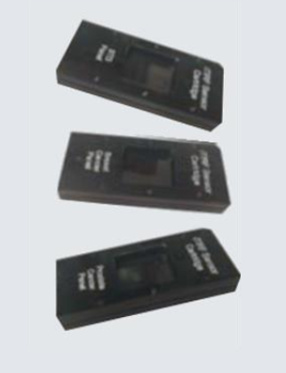
Deliverables
Home Use
Laboratory Use
i-Diagnostics® Reader
uTIRF station – one of the TIRF Analytix instruments
Other application development tools
Disposable microarray cartridges
www.TIRF-Labs.com

Slide 15
TIRF Labs’ Team and Principal Investigator
TIRF Labs’ team is described at URL: www.TIRF-Labs.com/i-diagnostics/about.
The Principal Investigator, Dr. Alexander Asanov, held academic positions at the Institute of Chemical Physics, Russian Academy of Sciences (RAS), the University of Alabama at Birmingham, and Mississippi State University. He received an M.S. degree in Biophysics from the Moscow Institute for Physics and Technology, and a Ph.D. degree in Chemical Physics from the Institute of Chemical Physics, RAS. His Ph.D. advisor was a Nobel Prize laureate N. N. Semenov; three other Nobel Prize winners, P. L. Kapitsa, A.D. Sakharov, and V. L. Ginzburg trained Dr. Asanov in several other areas of science.
Dr. Asanov has a broad background in spectroscopy, electrochemistry, molecular biology, cell biology, nanoengineering, chemistry and optics, which represent the key areas for the i-Diagnostics project. He has led successful R&D projects in the field of molecular diagnostics. The outcomes of the projects significantly exceeded expectations of the awards. In addition to prototypes, Dr. Asanov arranged manufacturing and established sales of 3 lines of TIRF Analytix products: turnkey TIRF instruments, TIRF accessories for microscopy, and TIRF accessory for spectroscopy. Dr. Asanov believes that he is well-suited to lead the proposed project. He pledged to give back to society his greatest assets: unique knowledge and skills, and believes that this non-profit project is the way of demonstrating his gratitude to America and to the world.
PUBLICATIONS AND AWARDS
50+ articles published in scientific journals.
$4M+ US government awards in BAA and SBIR grants.
RESEARCH AREAS
TIRF Spectroscopy, TIRF Microscopy, Electrochemistry, Molecular Engineering, Nanotechnology, Optical Engineering.
www.TIRF-Labs.com/i-diagnostics/Biosketch_Alexander_Asanov2025.pdf
www.TIRF-Labs.com

Slide 16

FDA Compliance, Literature, Contact Us
TIRF Labs complies with all FDA guidelines for medical device manufacturers. We adhere to the following FDA guidance:
Medical Device Software Guidance and Requirements.
Design Considerations for Devices Intended for Home-Use.
Guidance for Molecular Diagnostic Instruments with Combined Diagnostic and Research Functions.
  LITERATURE:
  Emanuel P, Caples M, Global CBRN Detector Market Survey, 2013, DOD, Joint Program Executive Office for Chemical and Biological Defense. 250 MB pdf file downloaded on May 1, 2015 from URL: http://www.cbrnlibrary.com/documents/Global%20CBRN%20Detector%2 0Market%20Survey_web.pdf; email your request to TIRF Labs at info@tirf-labs.com to receive the Survey 250 MB pdf file via Dropbox or Google Drive. 1A. Wired, Science, Bill Gates on COVID: Most US Tests Are ‘Completely Garbage’, Retrieved 2020, August, from https://www.wired.com/story/bill-gates-on-covid-most-us-tests-are-completely-garbage/
  Business Insider, Bill Gates says most COVID-19 tests in the US are 'completely garbage' because it takes too long to get results, Retrieved 2020, August, from https://www.businessinsider.com/bill-gates-covid-tests-us-completely-garbage-2020-8
  Turchin A., Green B.P., Denkenberger D., “Artificial Multipandemic as the Most Plausible and Dangerous Global Catastrophic Risk Connected with Bioweapons and Synthetic Biology”, Foundation for Longer Life, Moscow, Global Catastrophic Risk Institute, Tennessee State University, Santa Clara University, 2018, Retrieved 2020, August, from https://philpapers.org/rec/TURAMA-3
CONTACT US:
TIRF Labs, Inc., NC RTP, 517 Willard Woods Drive, Wendell, North Carolina 27591, USA
Tel: 919.463.9545 info@tirf-labs.com www.tirf-labs.com ©2025 TIRF Labs
www.TIRF-Labs.com

